Slide 1
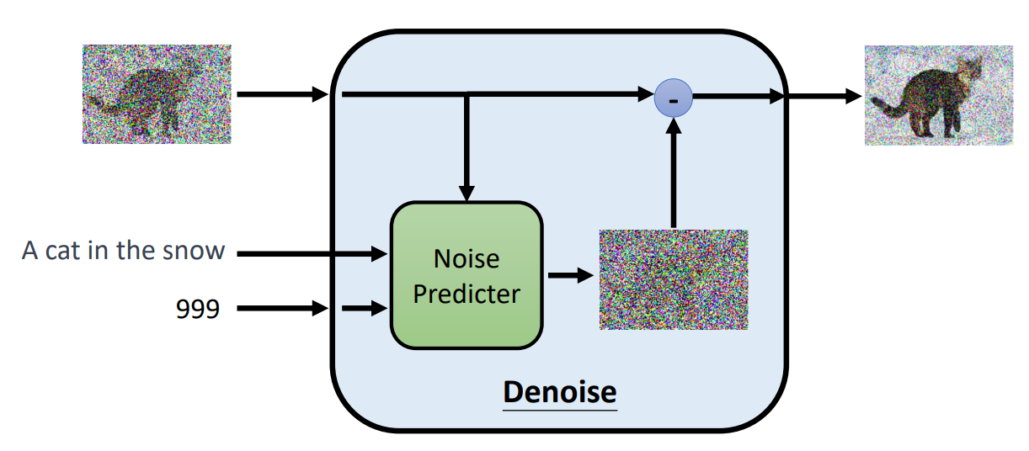
——Technique Project
Topic: Diffusion Model
From ML 2023 Spring (ntu.edu.tw)

Slide 2
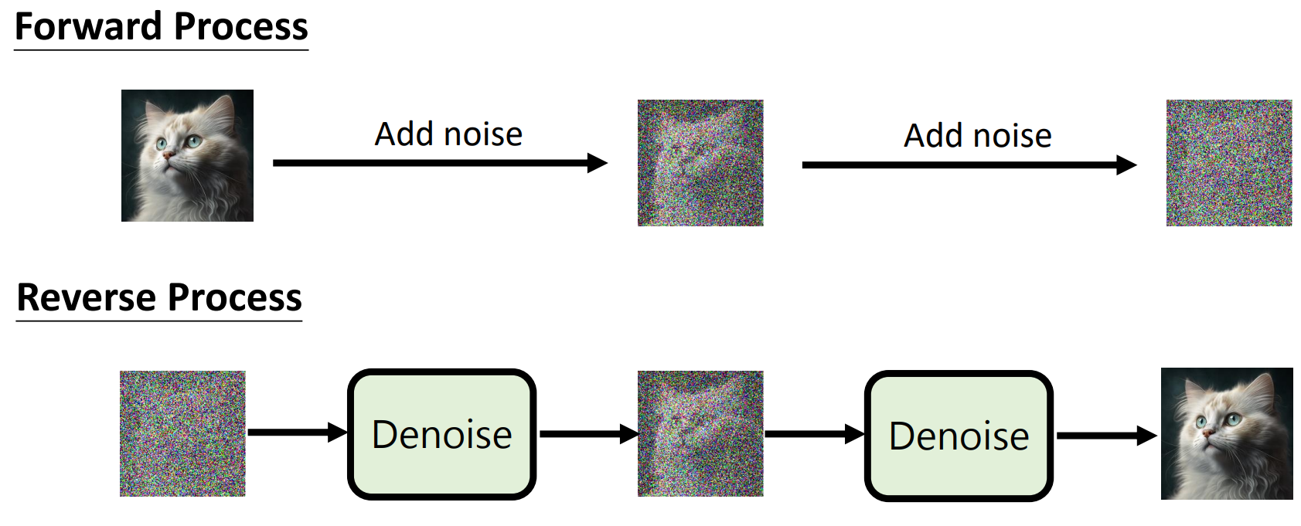
How Diffusion Model Work?
From ML 2023 Spring (ntu.edu.tw)

Slide 3


Denoise Process
Paint ×
Sculpt √
Powered by 文心一格

Slide 4
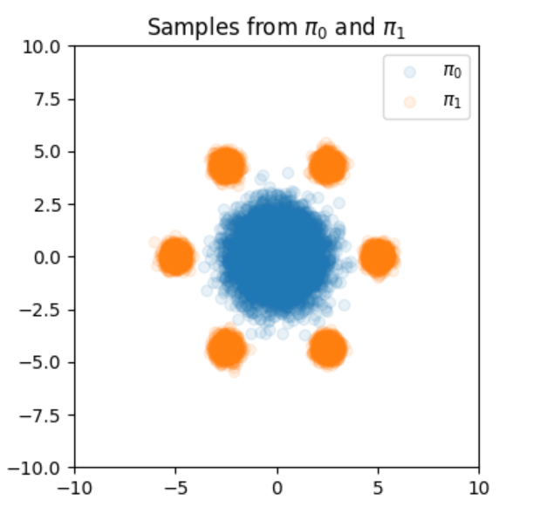
Technique Project of Group 5
——Pipeline of our work
Based on given incomplete project
obtain samples
construct diffusion model
train and test model
data visualization
Source code can be found in：https://www.kaggle.com/code/duankefeng/simplediffusion

Slide 5
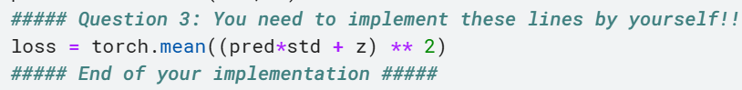
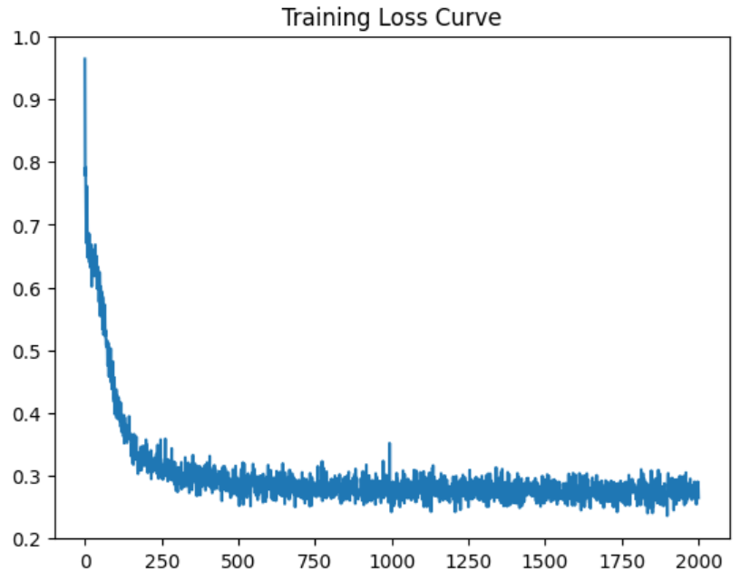
Technique Project of Group 5
—— Train Diffusion Model
Loss Function: MSE loss
➔pred: The output of the model at given time step t.
➔std: The standard deviation, typically computed from the marginal distribution of the SDE. In diffusion models, this represents the noise level.
➔z: The true data or noise sample used for calculating the model’s loss.
Source code can be found in：https://www.kaggle.com/code/duankefeng/simplediffusion

Slide 6
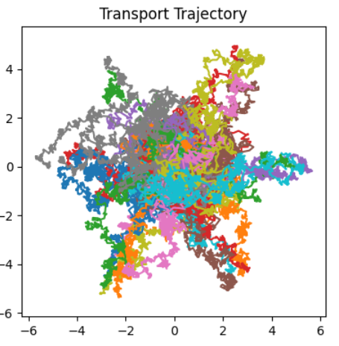
Technique Project of Group 5
—— Sample based on well-trained Diffusion model
Euler-Maruyama method used for SDE
z - drift * dt:
Adjusts the sample z by the deterministic drift term over the time step dt.
diffusin * torch.sqrt(torch.tensor(dt)) * noise
➔ Adds the stochastic component to z, scaled by the diffusion term and the time step size.
——simulating the reverse-time Stochastic Differential Equation (SDE)

Slide 7
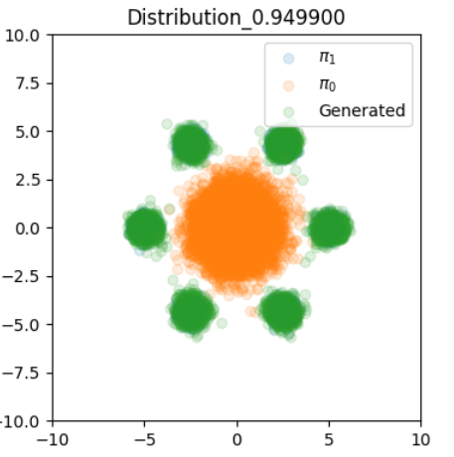
Technique Project of Group 5
—— Data Visualization

Slide 8
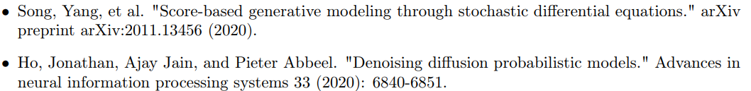
Technique Project of Group 5
—— Related Work
That’s all. Thank you!!!

